Slide 1
ENG 346 Data Structures and Algorithms for Artificial Intelligence Recursion
Dr. Mehmet PEKMEZCİ
mpekmezci@gtu.edu.tr
https://github.com/mehmetpekmezci/GTU-ENG-346

Slide 2
Agenda
Define: Recursion
Examples: Factorial, Fibonacci Numbers
Designing Recursive Algorithms
Example: Towers of Hanoi
Tail Recursion

Slide 3
Recursion
When a function calls itself…We have recursion.
Such function/algorithm is called recursive function/algorithm.
Base case(s)
Values of the input variables for which we perform no recursive calls are called base cases (there should be at least one base case).
Every possible chain of recursive calls must eventually reach a base case.
Recursive calls
Calls to the current method.
Each recursive call should be defined so that it makes progress towards a base case.

Slide 4
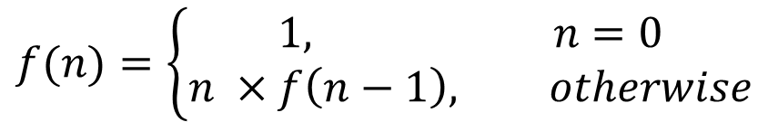
Example: Factorial
def f(n):
if n == 0: return 1
else: return n * f(n-1)

Slide 5
Example: Factorial – continued
def f(n):
print ("Called with n=", n)
if n == 0: return 1
else: return n * f(n-1)
f(4) # 4!
Output:
Called with n= 4
Called with n= 3
Called with n= 2
Called with n= 1
Called with n= 0
24

Slide 6
Example: Factorial – continued
Initial call
return
4
*
6
=
24
final answer
f(4)
Recursive call
return
3
*
2
=
6
f(3)
Recursive call
return
2
*
1
=
2
f(2)
Recursive call
return
1
*
1
=
1
f(1)
Recursive call
return
1
f(0)

Slide 7
Example: Number Guess
Pick a number between 1 and 100.

Slide 8
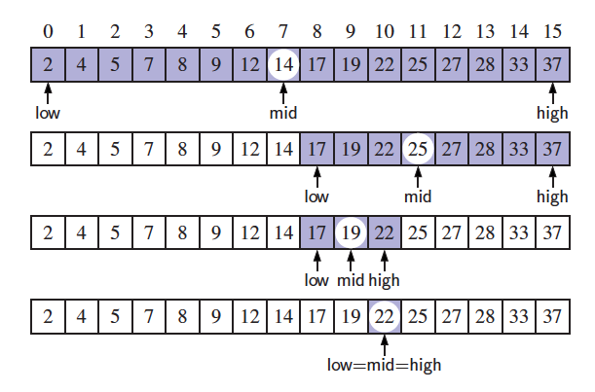
Example: Binary Search
Search for an integer “target” in an ordered list.

Slide 9
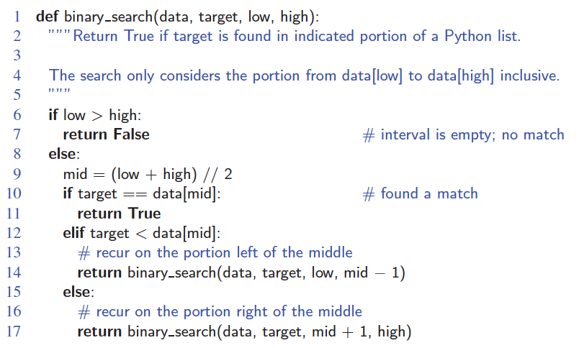
Example: Binary Search – continued

Slide 10
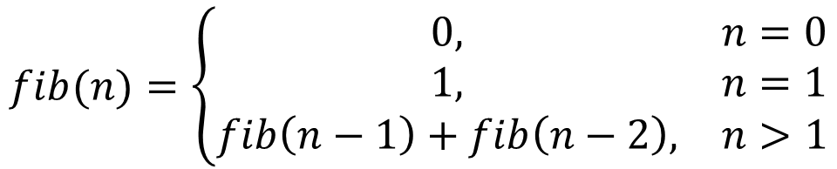
Fibonacci Numbers
fib(0) = 0
fib(1) = 1
fib(2) = 1 + 0 = 1
fib(3) = 1 + 1 = 2
fib(4) = 2 + 1 = 3
fib(5) = 3 + 2 = 5
fib(6) = 5 + 3 = 8
fib(7) = 8 + 5 = 13
fib(8) = 13 + 8 = 21

Slide 11
Fibonacci Numbers – continued
Calls for fib(0) = 1
Calls for fib(1) = 1
Calls for fib(2) = 1 + 1 + 1 = 3
Calls for fib(3) = 1 + 3 + 1 = 5
Calls for fib(4) = 1 + 5 + 3 = 9
Calls for fib(5) = 1 + 9 + 5 = 15
Calls for fib(6) = 1 + 15 + 9 = 25
Calls for fib(7) = 1 + 25 + 15 = 41
Calls for fib(8) = 1 + 41 + 25 = 67
Basically:
Call for fib(n) > 2^(n/2)
Exponential runtime!

Slide 12
Fibonacci Numbers – continued
def fib2(n):
"""Return the nth Fibonacci number."""
if n <= 1: return (n,0)
else:
(a, b) = fib2(n-1)
return (a+b, a)

Slide 13
Designing Recursive Algorithms
Test for base cases:
There should be at least one.
Base case should not contain recursion.
Recursive step:
Perform one or more recursive calls.
Input size (or length) should decrease with each recursive call.
Chain of recursive calls should reach to base case.

Slide 14
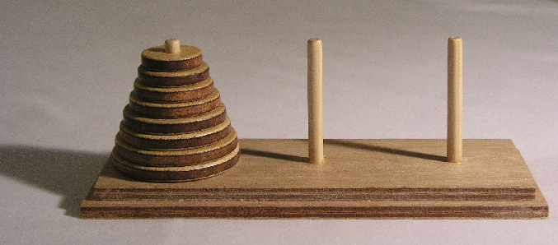
Example: Towers of Hanoi
Game rules:
Only one disk may be moved at a time.
Each move consists of taking the upper disk from one of the stacks and placing it on top of another stack or on an empty rod.
No disk may be placed on top of a disk that is smaller than it.
Notes:
Puzzle

Slide 15
Example: Towers of Hanoi – continued

Slide 16
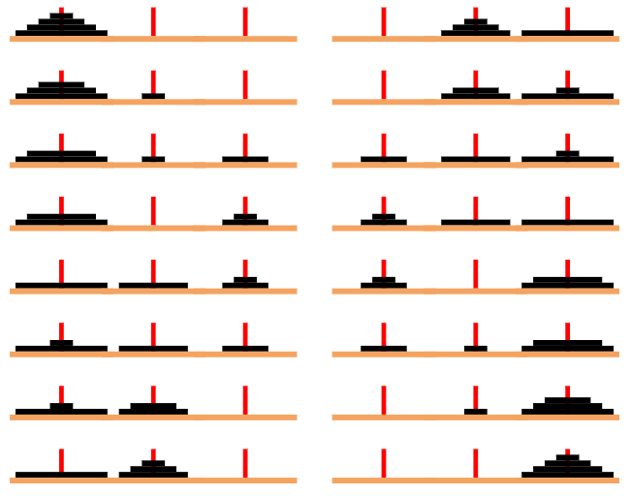
Example: Towers of Hanoi – continued

Slide 17
Example: Towers of Hanoi – continued
def TowerOfHanoi(n , source, destination, auxiliary):
if n==1:
print ("Move disk 1 from source",source,"to destination",destination)
return
TowerOfHanoi(n-1, source, auxiliary, destination)
print ("Move disk",n,"from source",source,"to destination",destination)
TowerOfHanoi(n-1, auxiliary, destination, source)

Slide 18
Tail Recursion
Recursive call is the last step of the function.
Function returns immediately after recursive call.
Eliminating tail recursion will clear any overhead resulting from recursive function calls.

Slide 19
Iterative Binary Search
def binary_search_iterative(data, target):
"""Return True if target is found in the given Python list."""
low = 0
high = len(data) - 1
while low <= high:
mid = (low + high) // 2
if target == data[mid]: # found a match
return True
elif target < data[mid]:
high = mid - 1 # only consider values left of mid
else:
low = mid + 1 # only consider values right of mid
return False # loop ended without success

Slide 20
Exercises
R-4.1 Describe a recursive algorithm for finding the maximum element in a sequence, S, of n elements. What is your running time and space usage?
R-4.7 Describe a recursive function for converting a string of digits into the integer it represents. For example, “13531” represents the integer 13,531.
Notes:
R-4.1) Hint Don’t forget about the space used by the function stack.
R-4.1) Solution If the sequence has 1 element, that is the maximum. Otherwise, consider the bigger of the first element or the maximum of the
other n−1 elements. The running time and space usages is O(n).
R-4.7) Hint Process the string left to right.
R-4.7) Solution Use a single-digit as the base case. For a multiple-digit
string, let s′ = sd for digit d. We have that value(s′) = d+10 * value(s).

